Slide 1
Sandwich Bot
Camille d’Abreu

Slide 2
Objective
Create a fun bot that generates sandwich recipes with creative names.
Print recipes onto images that will be posted.
Implement hashtags in order to draw in a following.
Interact with other twitter accounts by either retweeting posts, or responding to tweets.

Slide 3
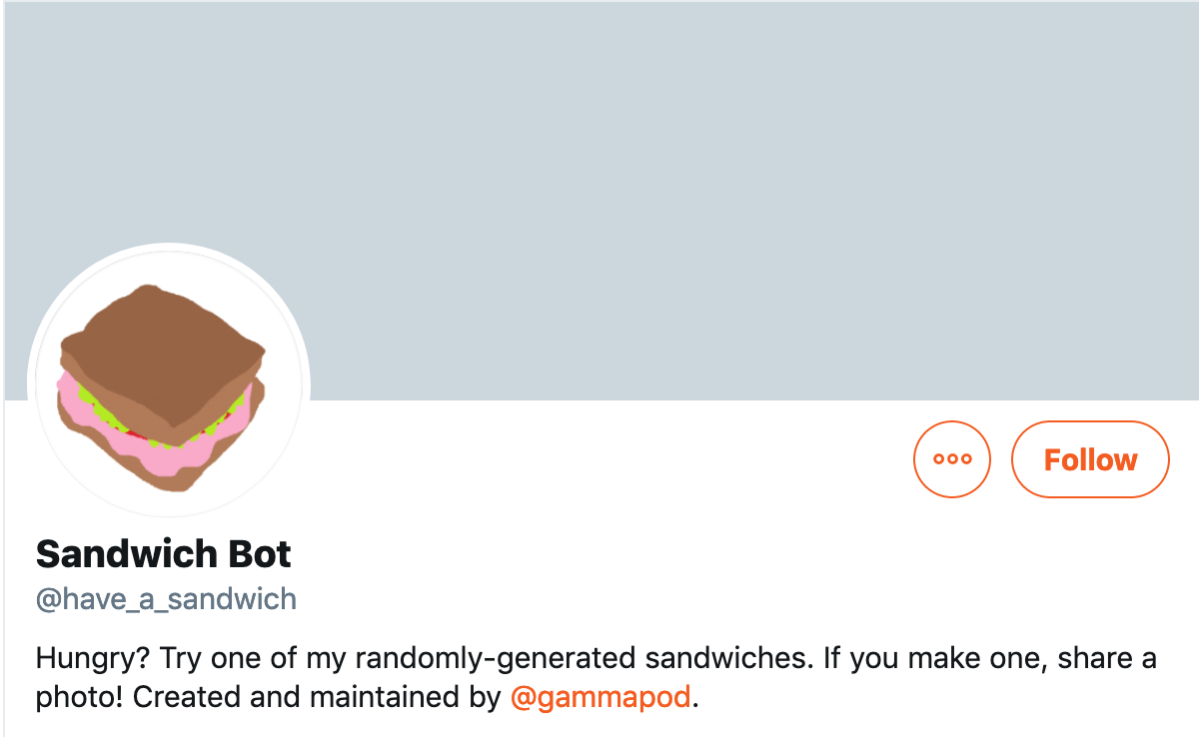
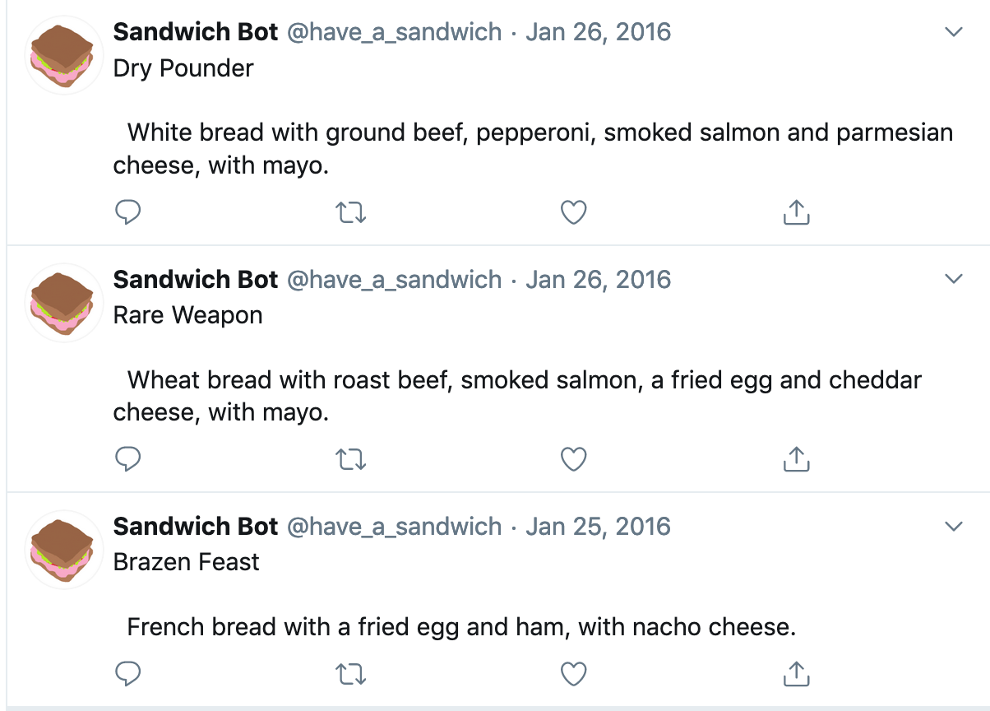
Existing Bots

Slide 4
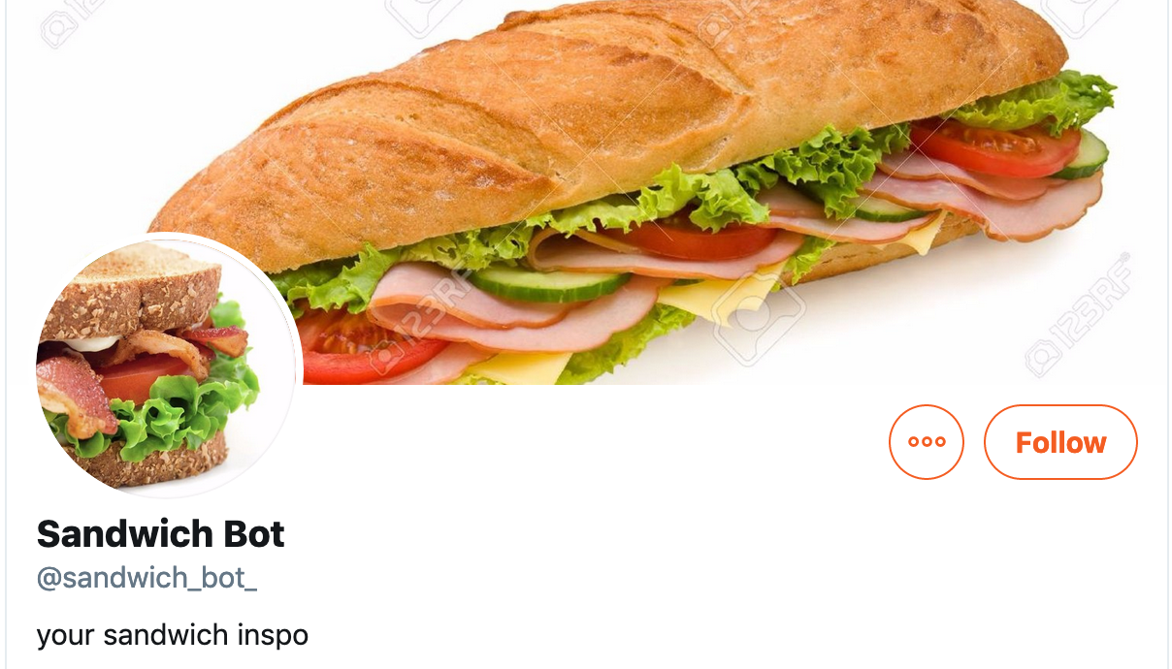
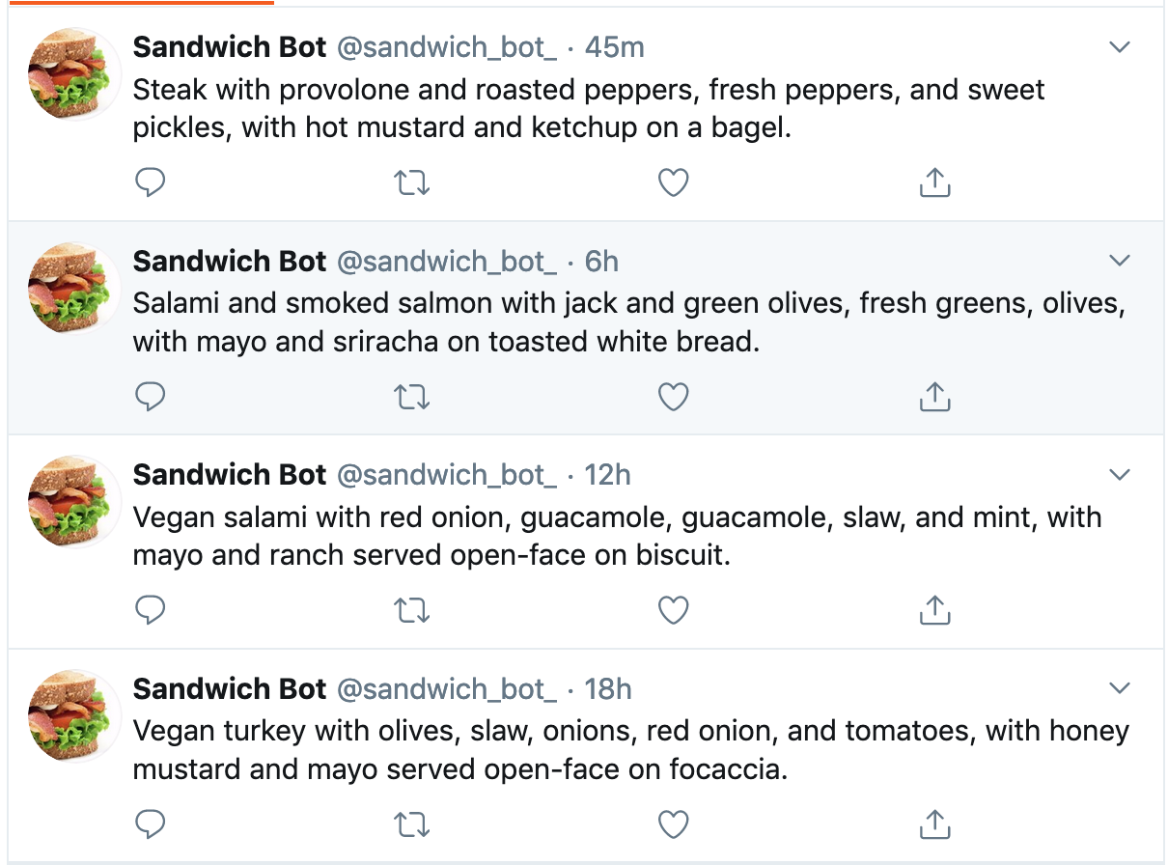
More Existing Bots

